Slide 1
LabA
Using HLS IP in IP Integrator
309804018 張珈源

Slide 2
OUTLINE
System overview
original code/pragmas
Dataflow viewer
timing/performance/utilization
Simulation waveform

Slide 3
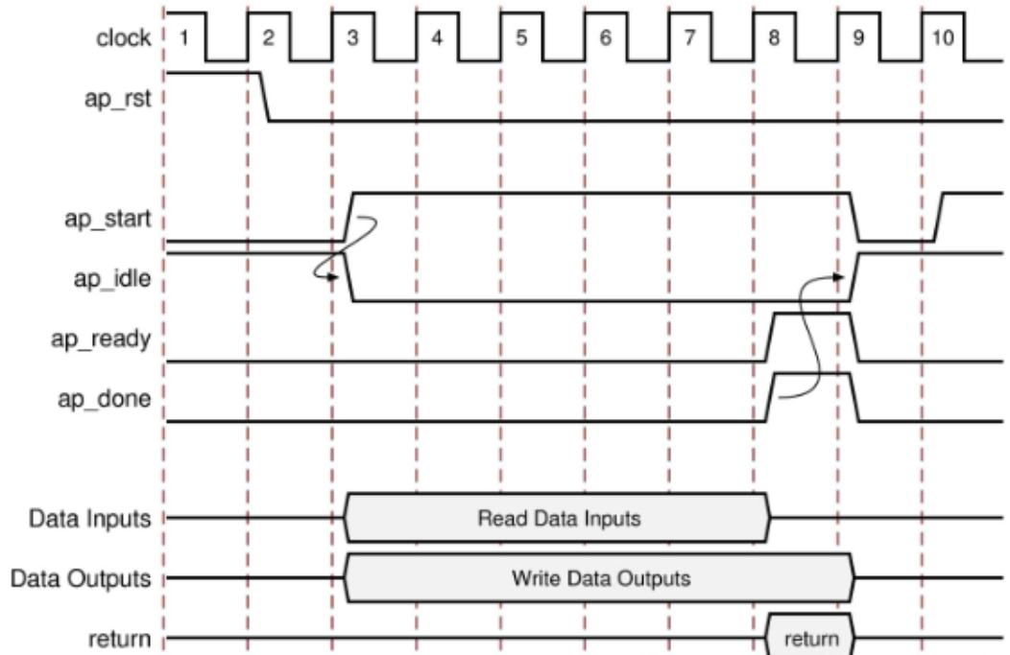
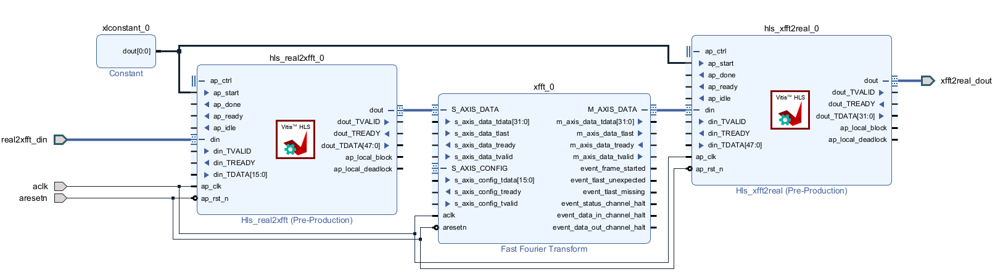
System overview

Slide 4
• The Xilinx FFT IP block only operates on complex data. Although you can perform an FFT of real data on a complex data set with all imaginary components set to zero, it can be done more efficiently by pre-processing the data.
• The front-end HLS block in this lab applies a Hamming windowing function to the 1024 (N) real data samples and sends even/odd pairs to an N/2-point XFFT as though they are complex data.
• The back-end HLS block takes bit-reverse ordered data, puts it in natural order and applies an O(N) transformation to FFT output to extract the spectral data for the N-point real data set. Note, the first output pair packs the 0th and 512th (purely real) spectral data point into the real and imaginary parts, respectively.

Slide 5
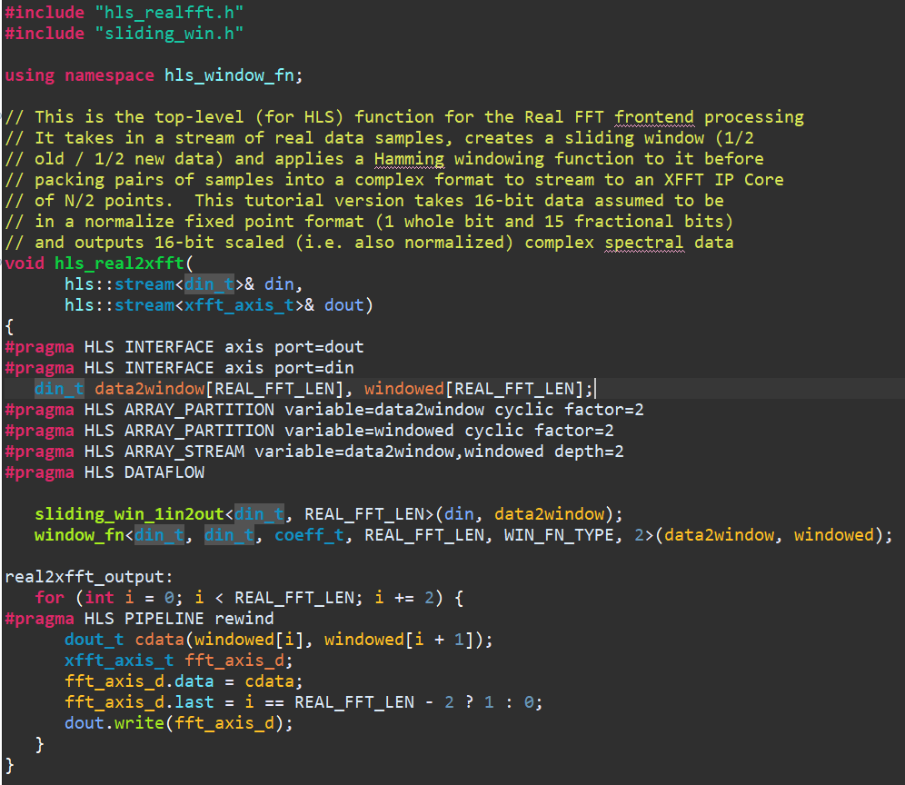
original code/pragmas
Real2xfft.cpp

Slide 6
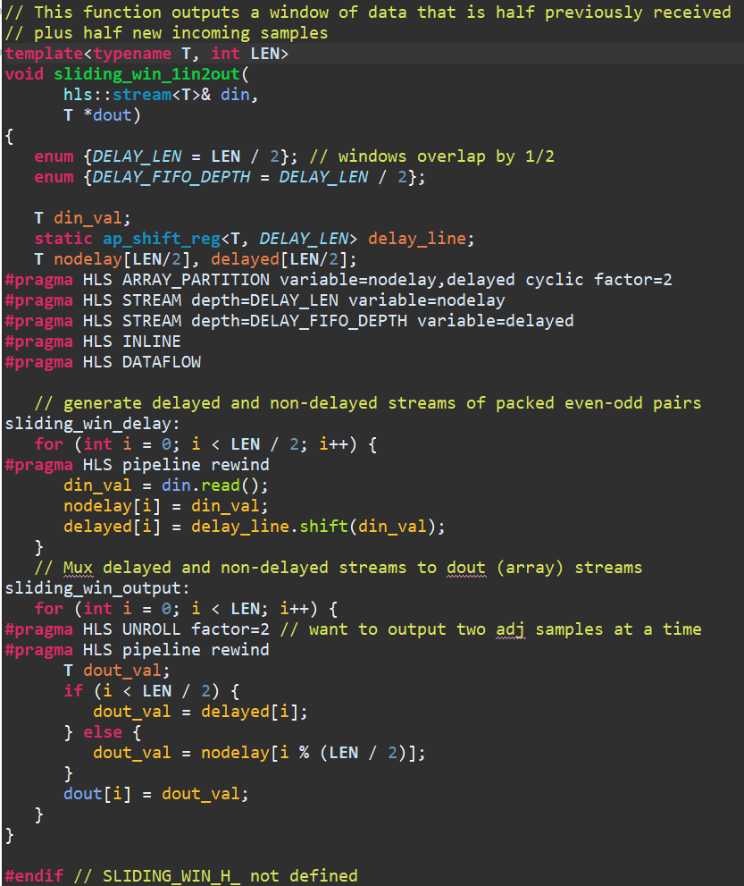
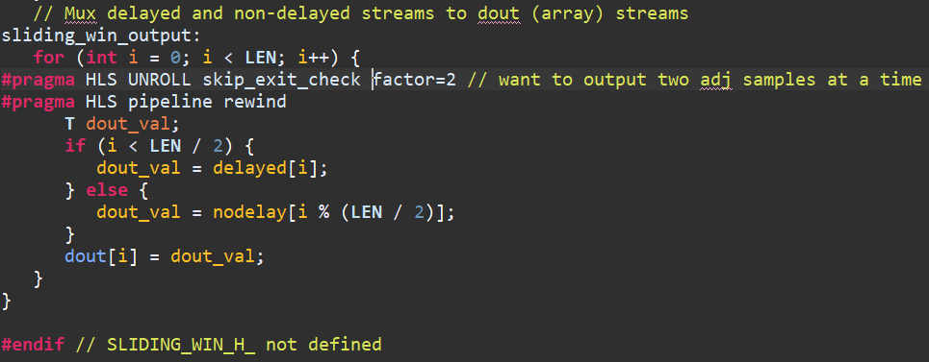
Sliding_win.h
Unroll skip_exit_check due to LEN=even(1024)

Slide 7
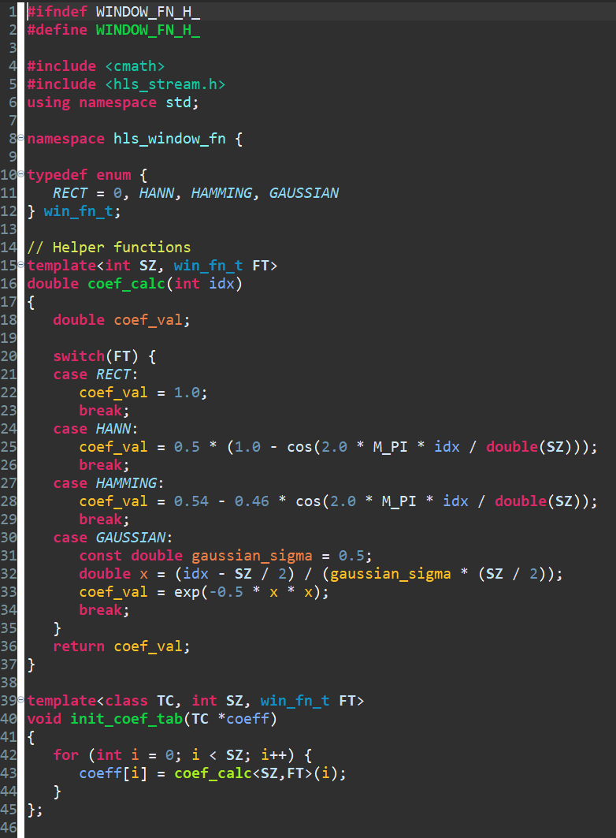
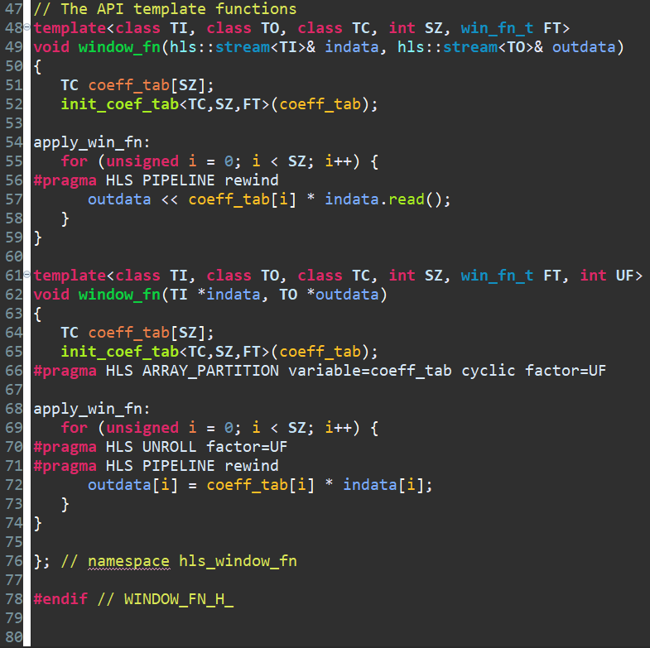
Window_fn.h

Slide 8
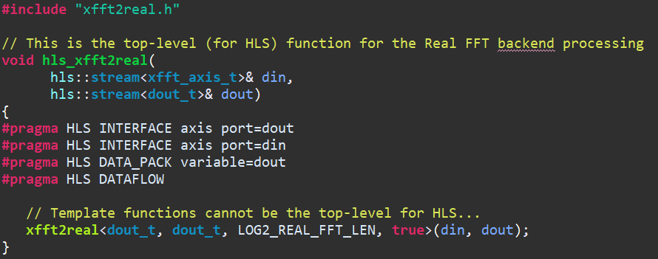
Xfft2real.cpp

Slide 9
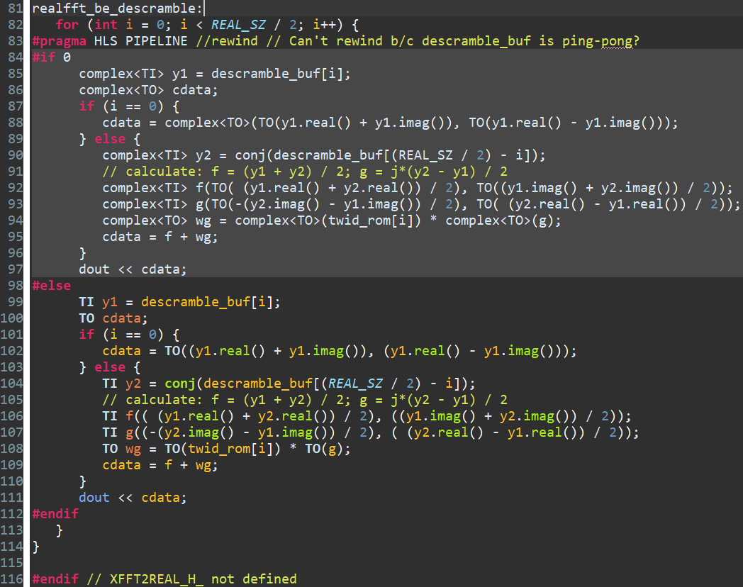
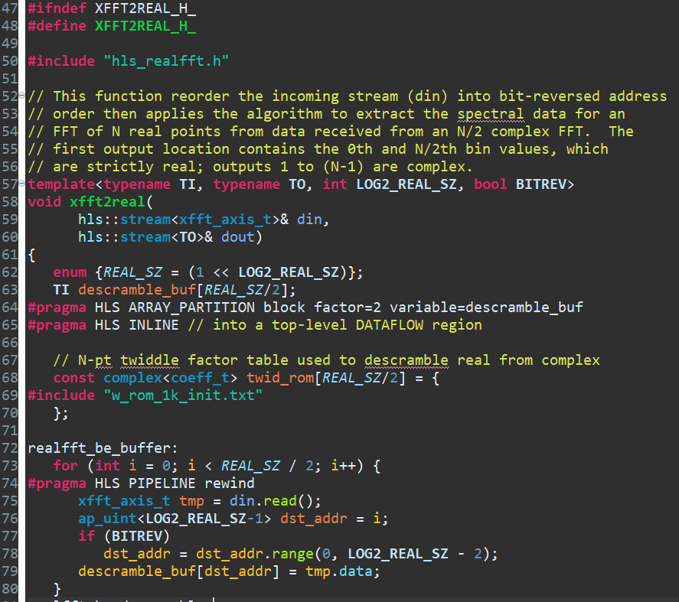
Xfft2real.h

Slide 10
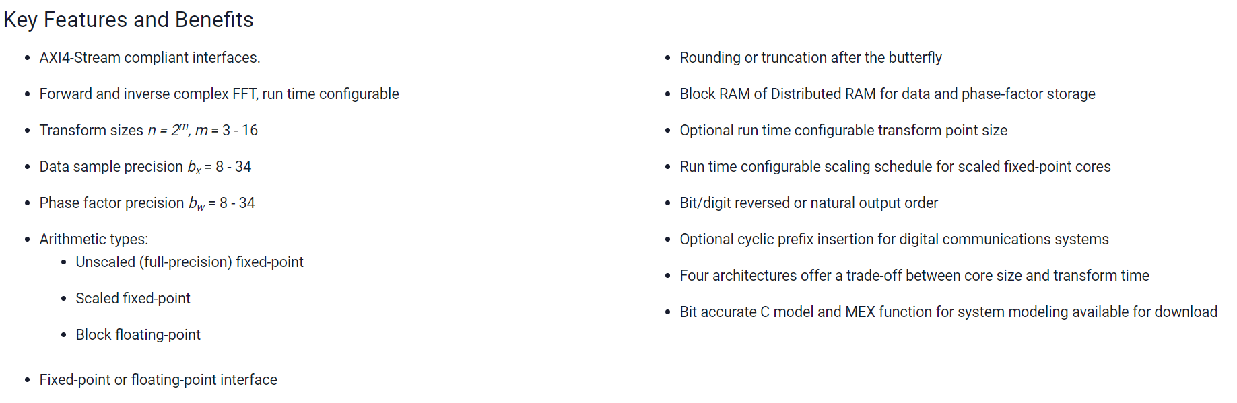
xfft

Slide 11
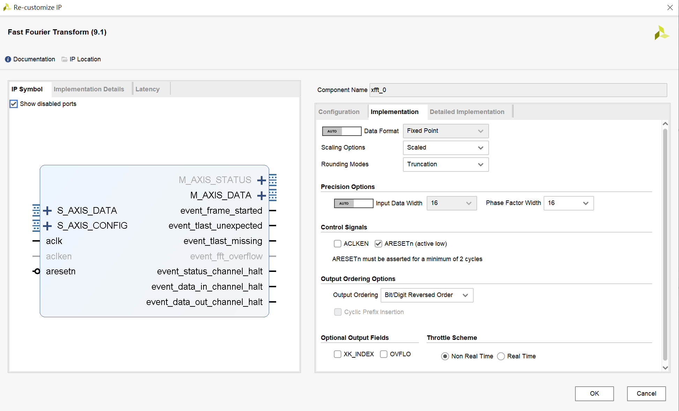

Slide 12
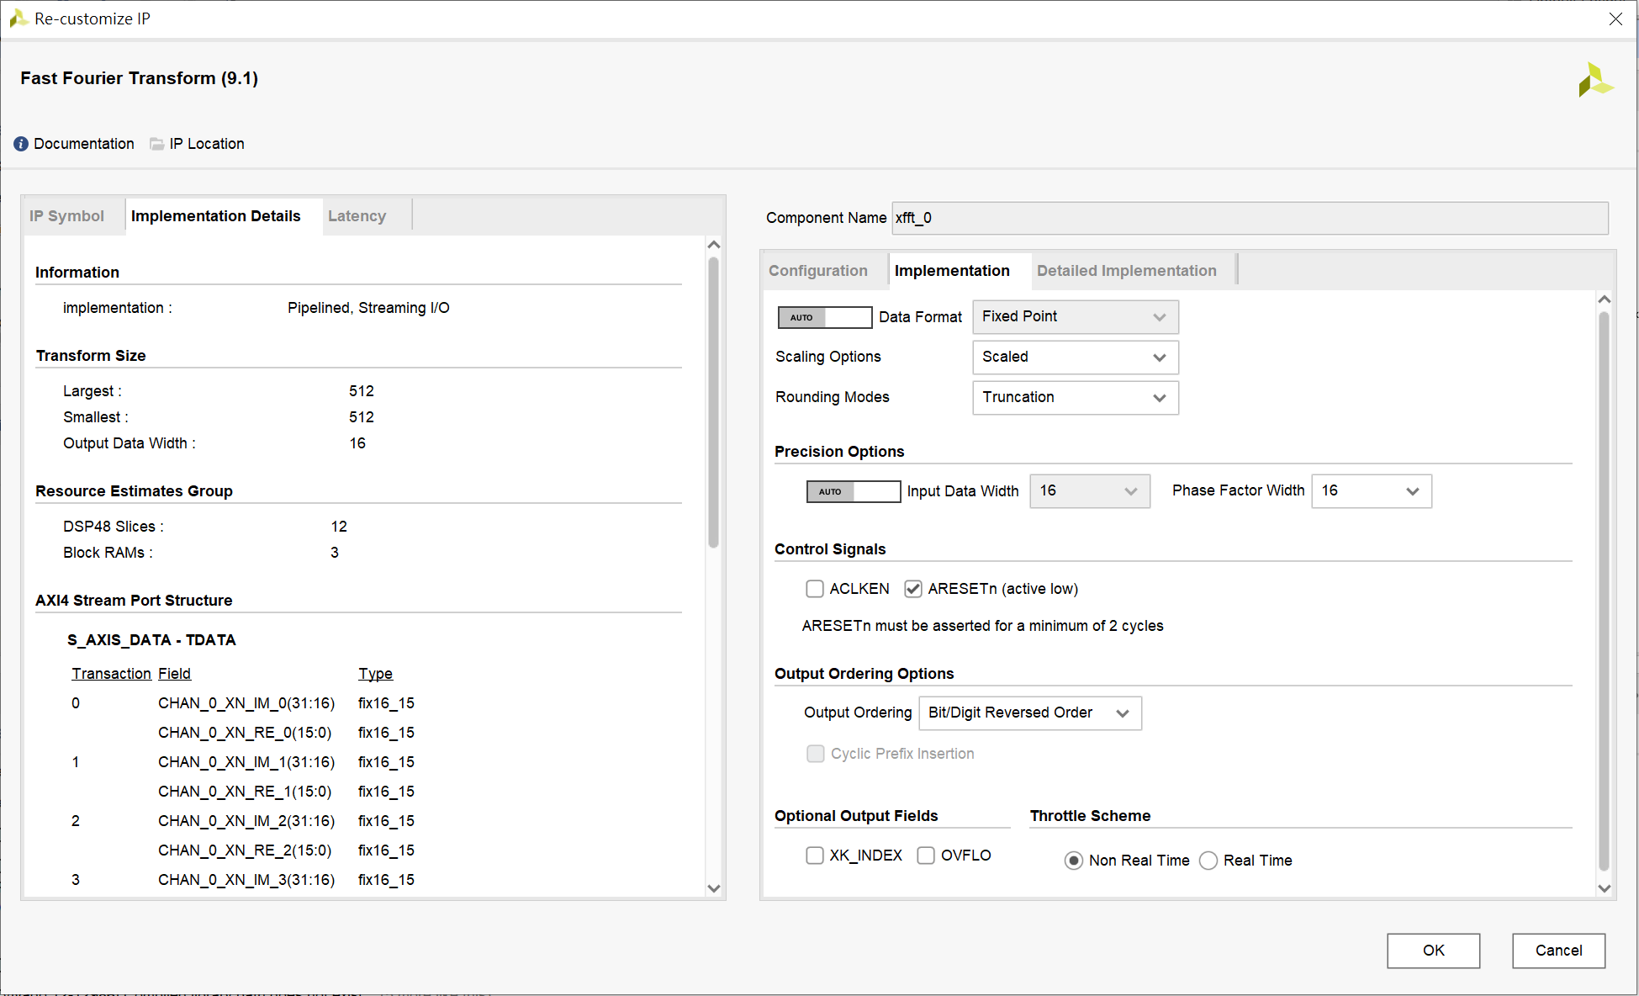

Slide 13
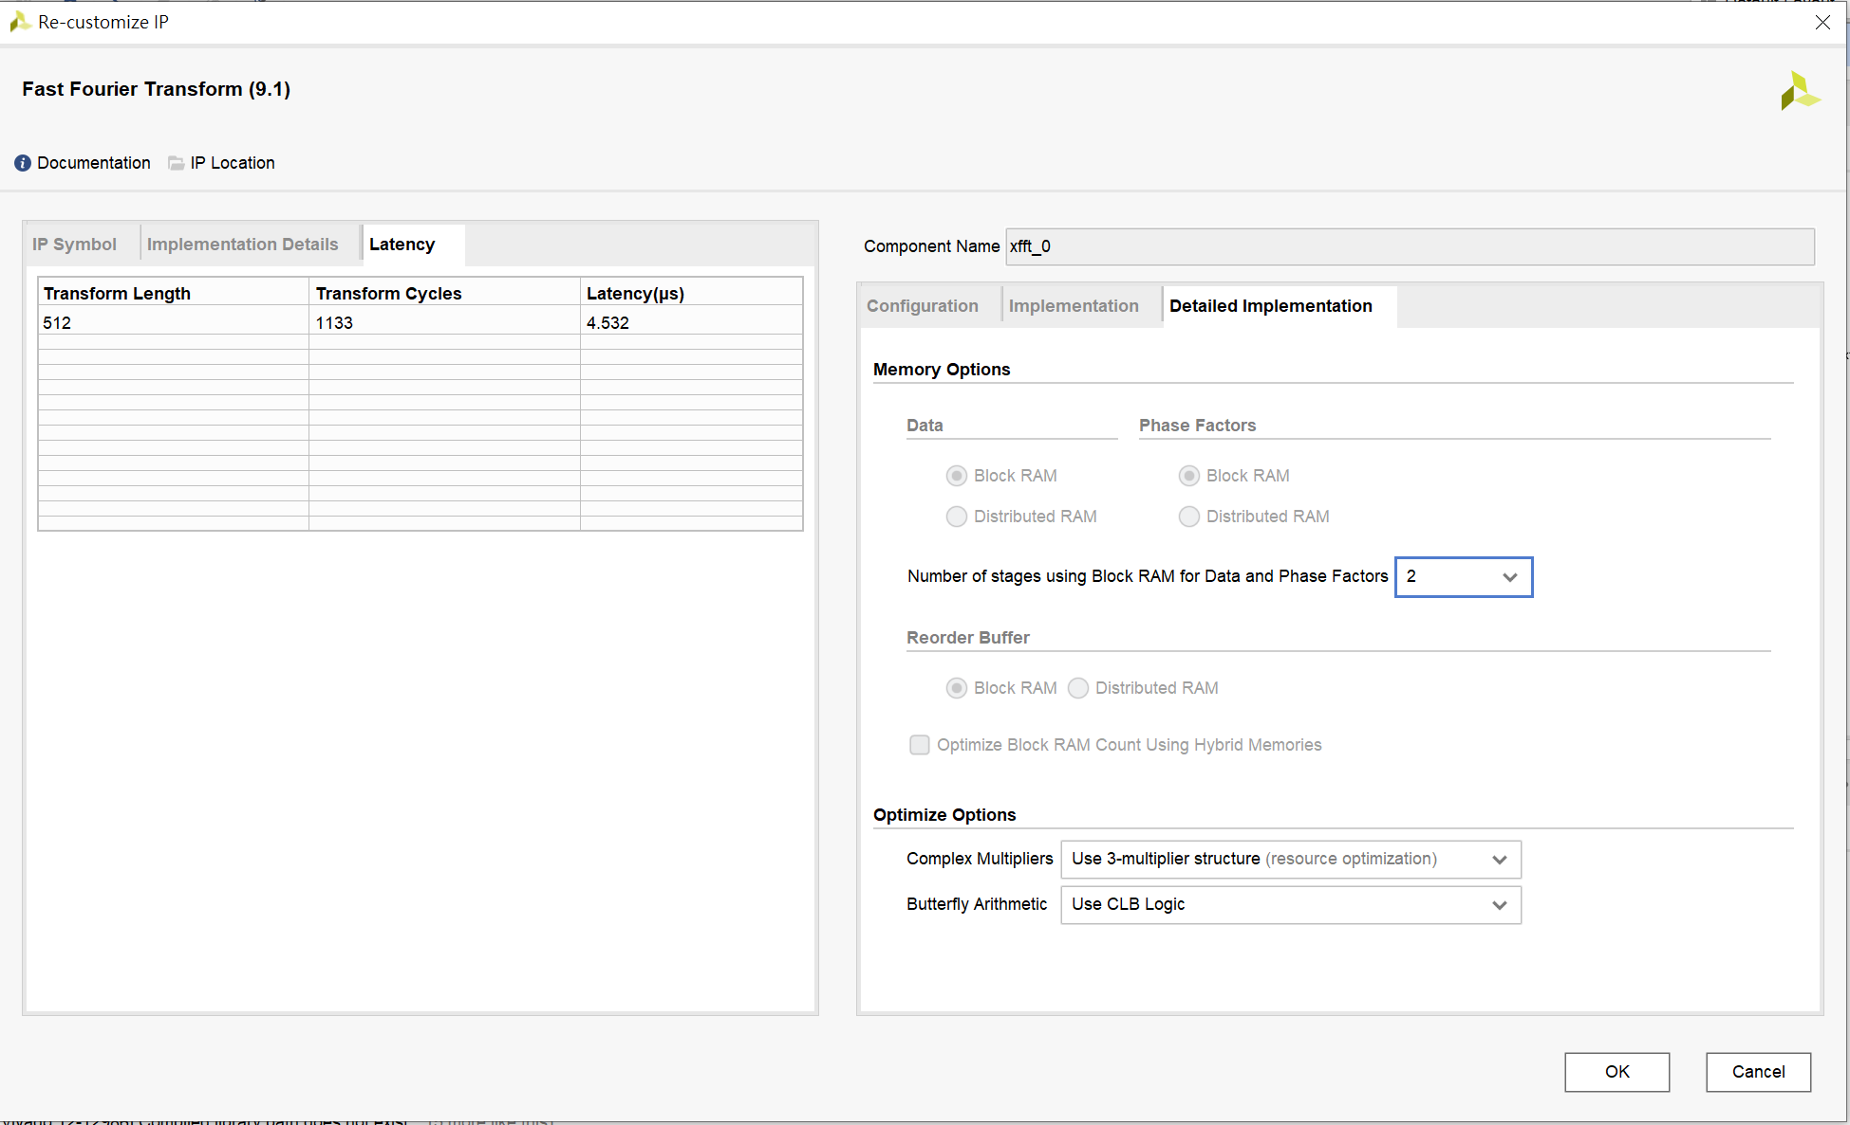

Slide 14
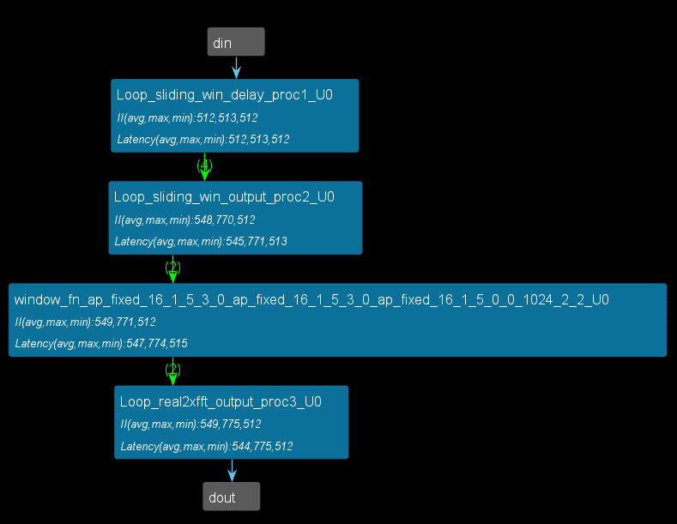
DataFlow viewer

Slide 15
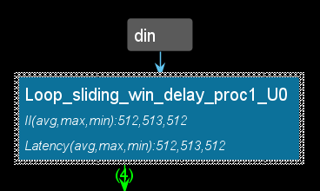
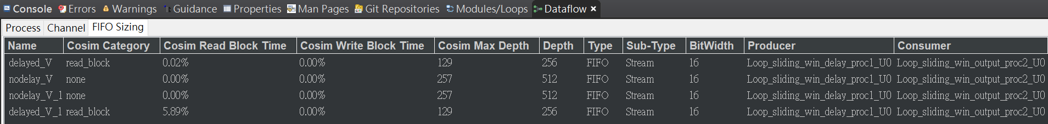
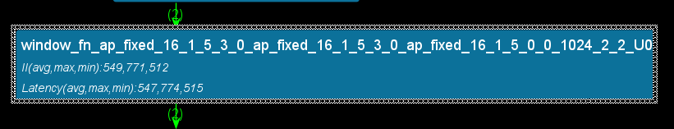
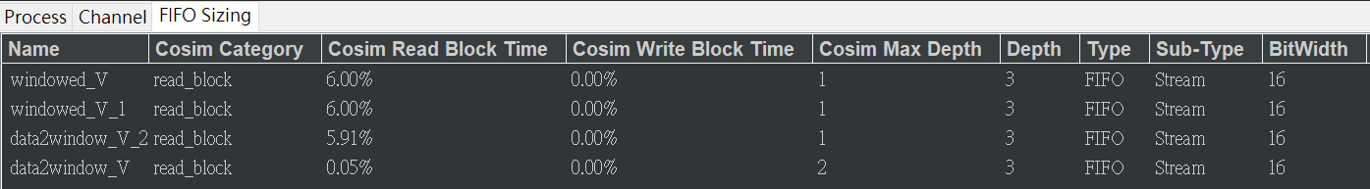

Slide 16
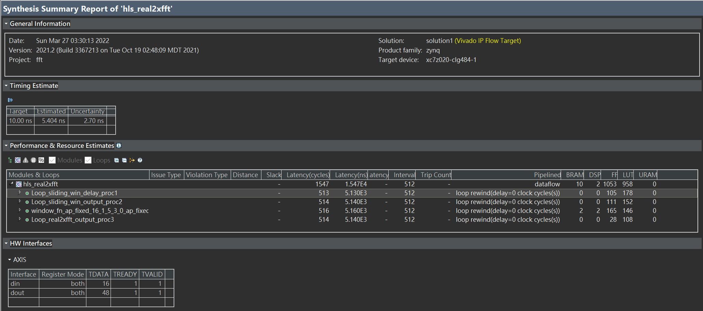
timing/performance/utilization
real2xfft

Slide 17
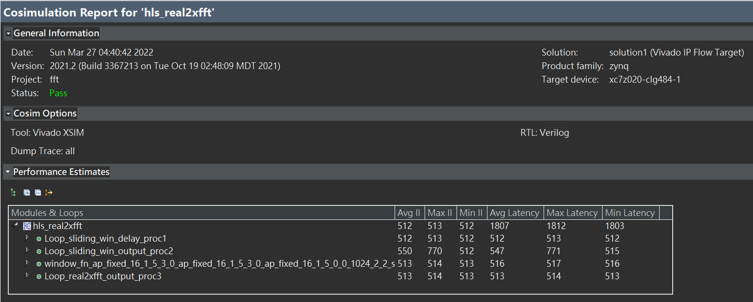

Slide 18
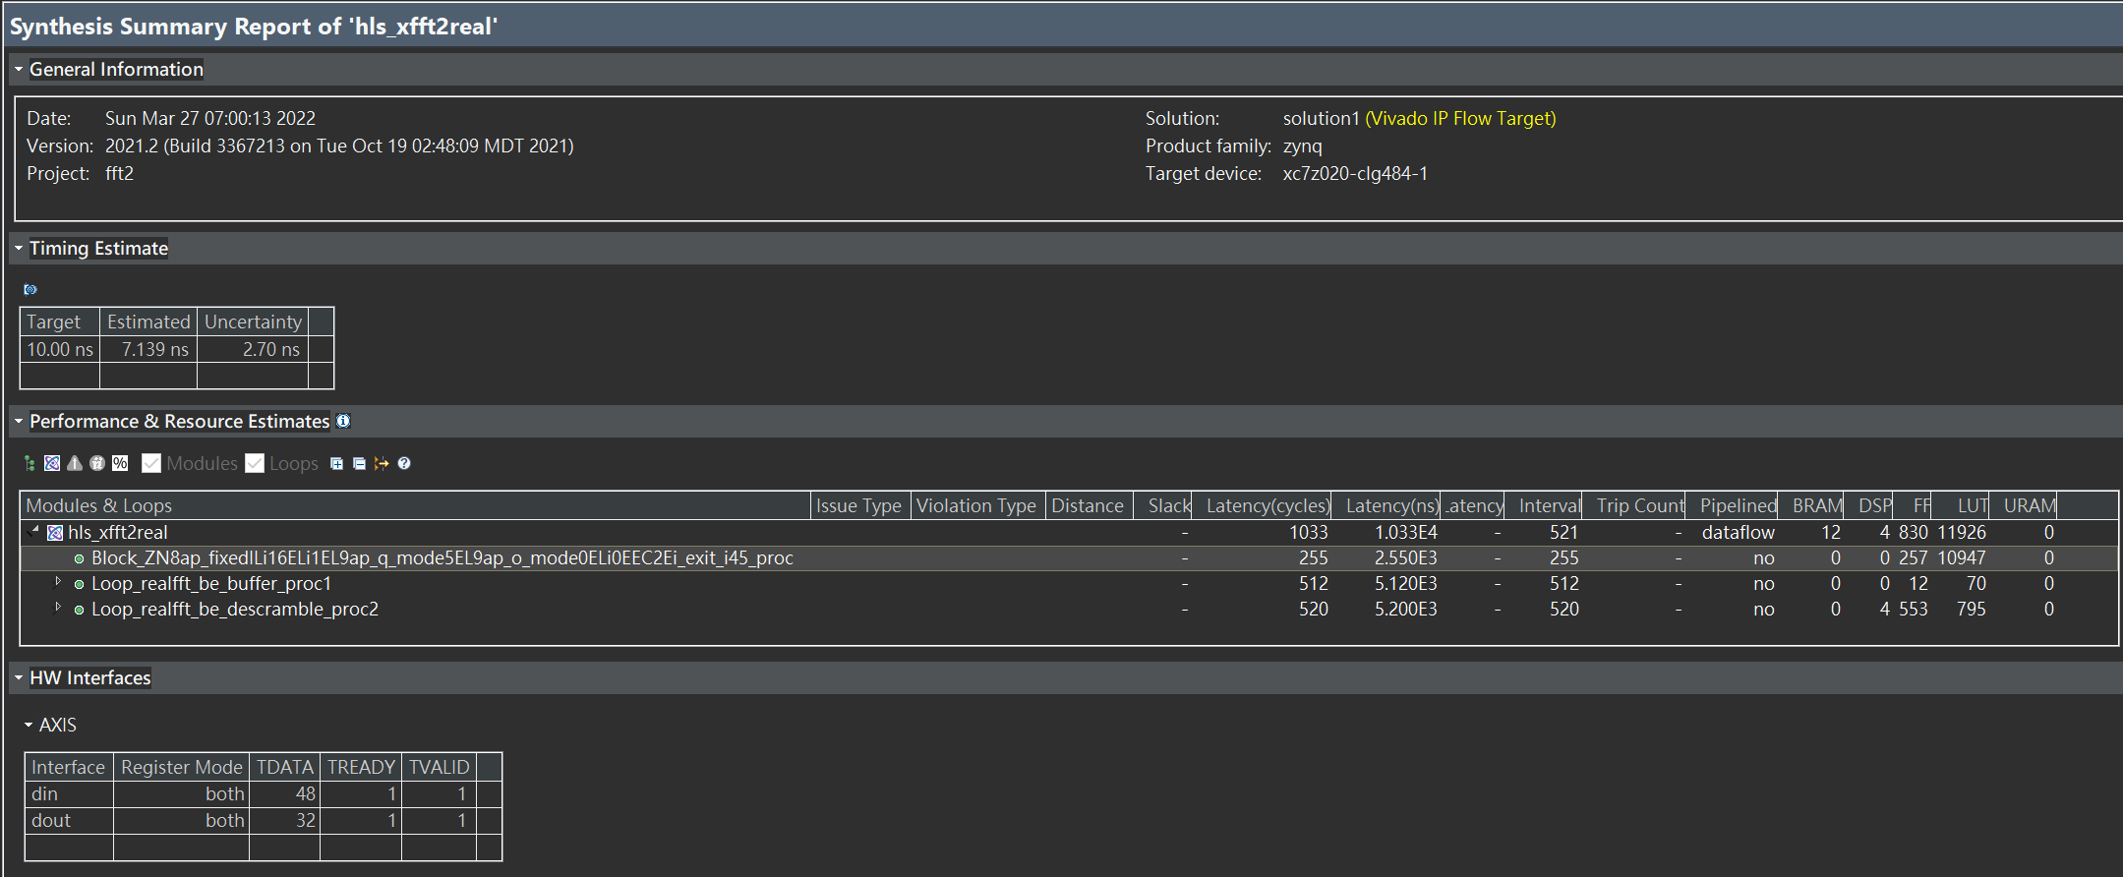
xfft2real

Slide 19
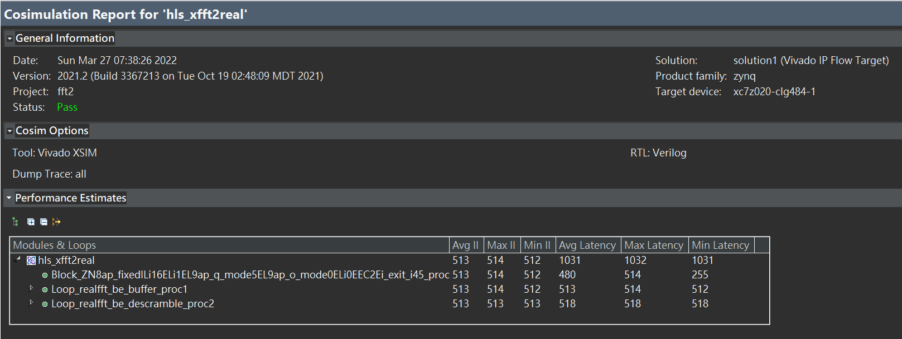

Slide 20
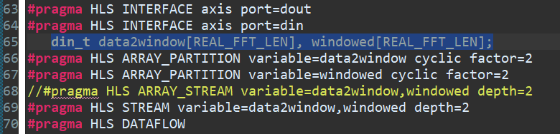
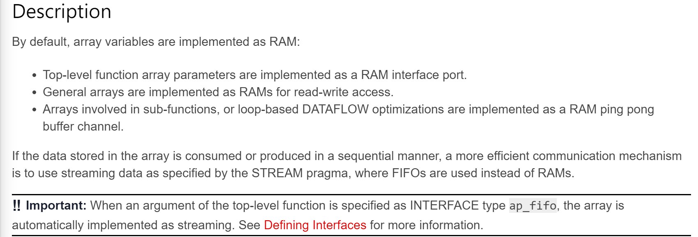

Slide 21
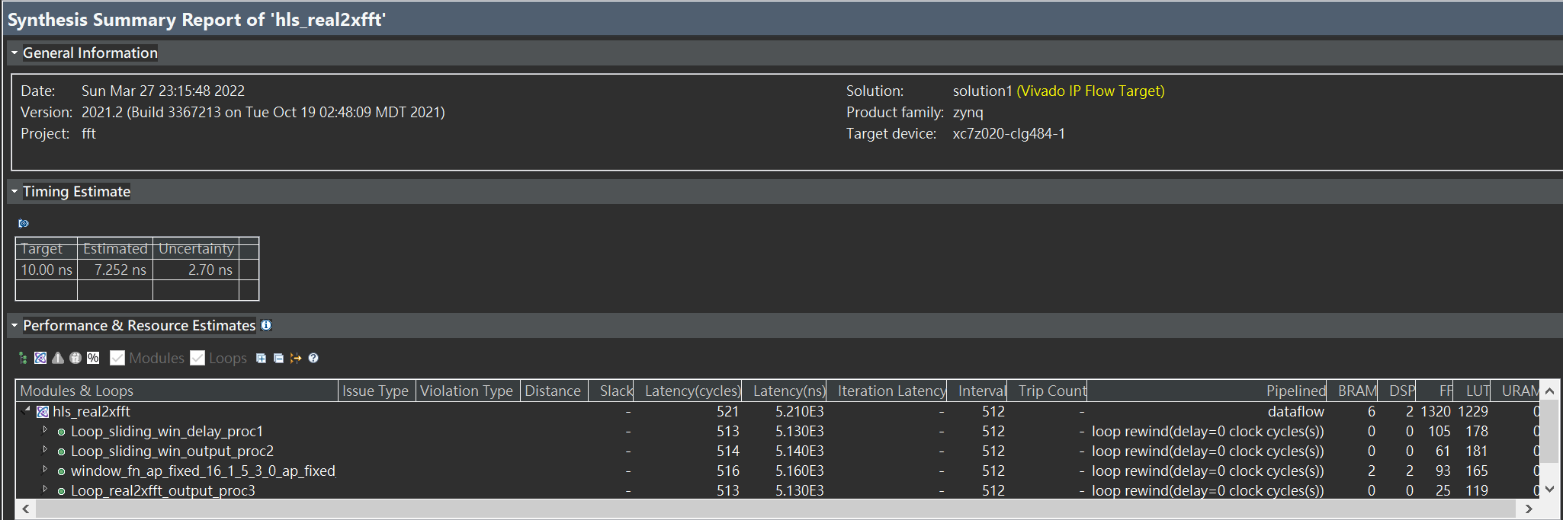

Slide 22
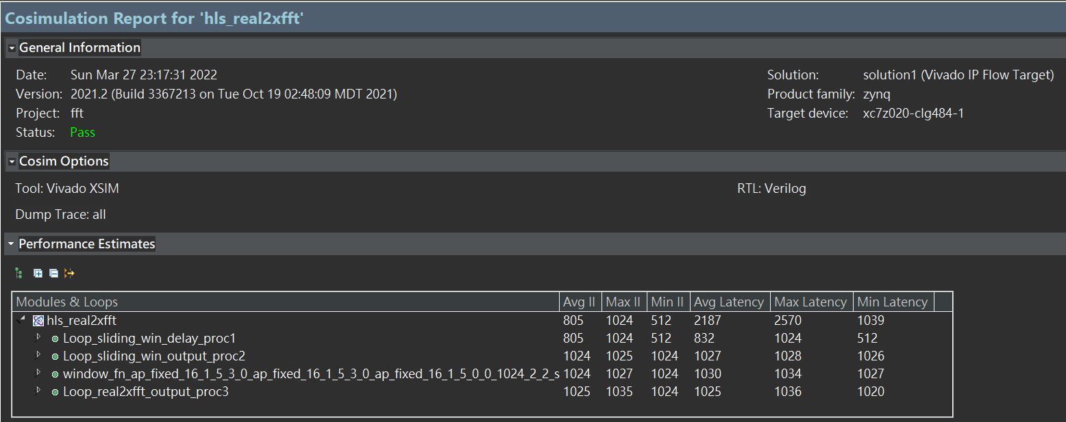

Slide 23
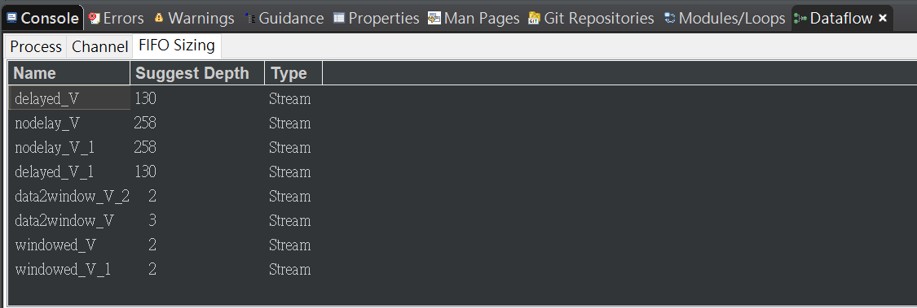
Co-Sim with channel(FIFO) profiling

Slide 24
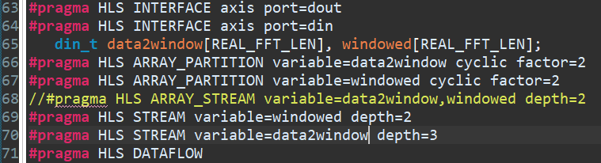
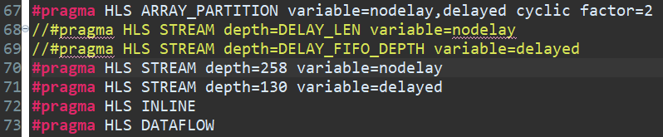

Slide 25
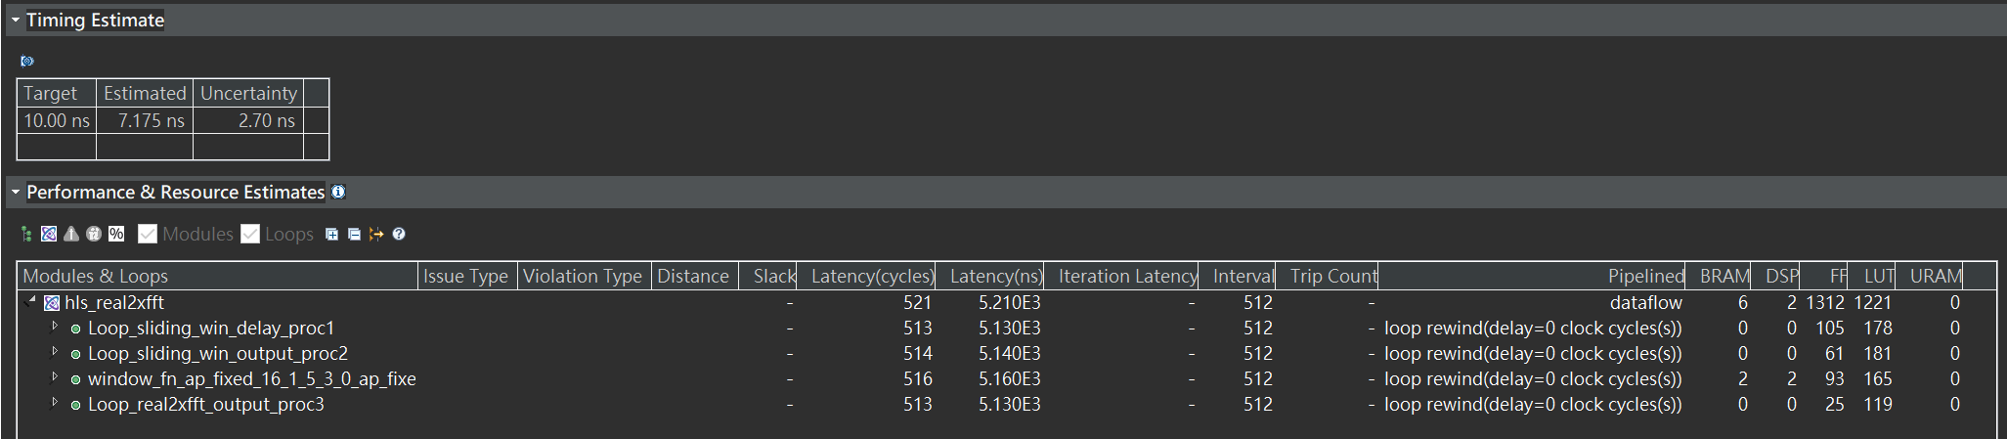
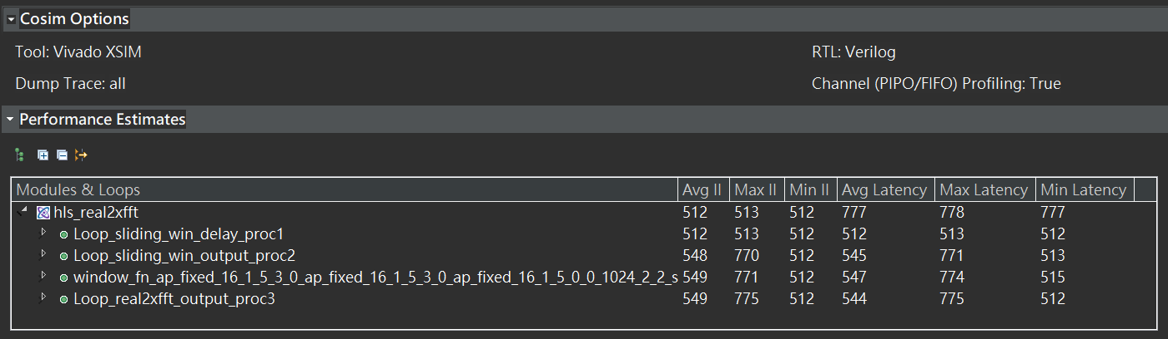

Slide 26
the result of replacing UNROLL to UNROLL skip_exit_check is no difference in the report.
For FIFO depth>3 ,the improvement of latency is almost the same, but may increase the area of hardware.

Slide 27
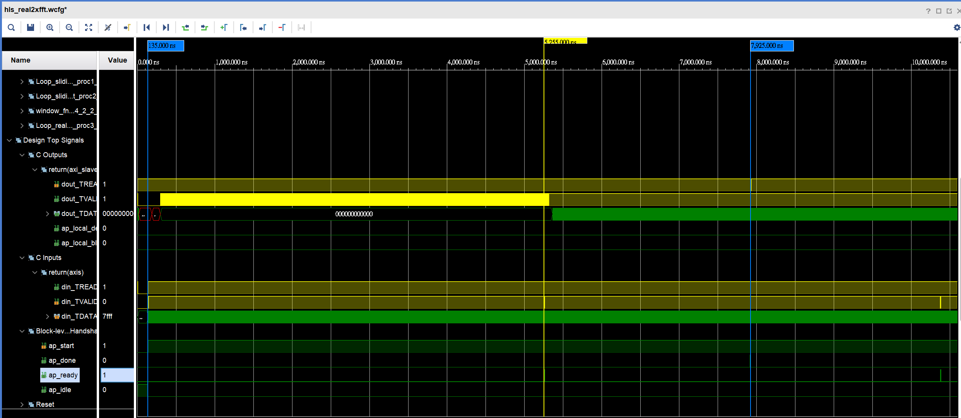
Co-sim waveform(real2xfft)
Q: The maximum burst length of AXI4-STREAM can reach 512?

Slide 28
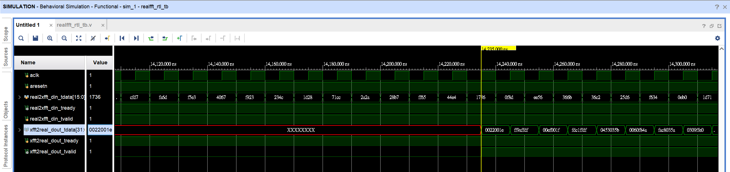
Behavior sim

Slide 29
Github
https://github.com/untitle1/UG871_FFT/upload/main

